Slide 1


Elastic [name of group]
Date:

Slide 2
[Insert name of meetup]
[name of organizer], [email organizer [position in Elastic]

Slide 3
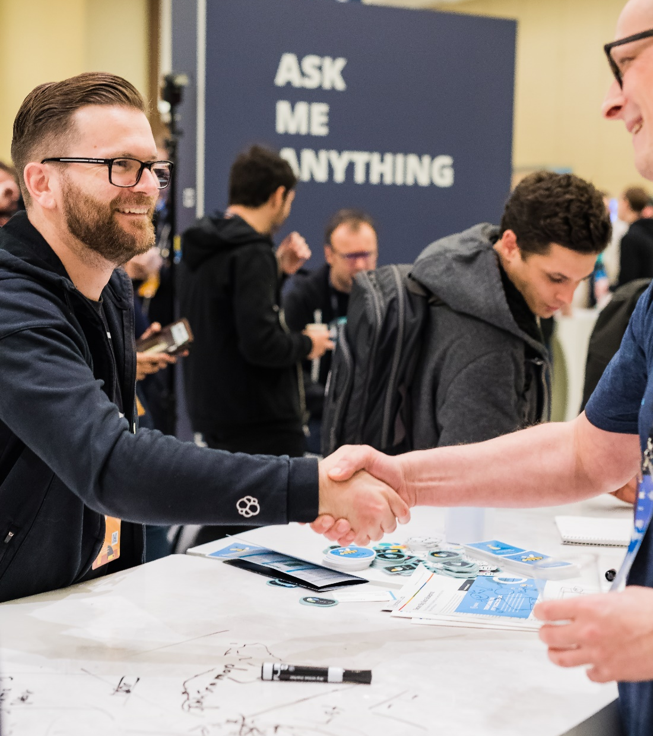









Agenda
FOUNDATION
19:00 PM
-
19:25 PM
-
19:30 PM
-
20:00 PM
-
20:30 PM
-
LOGGING
METRICS
APM
SPECIALIZATIONS
ADVANCED SEARCH
SECURITY ANALYTICS
DATA SCIENCE

Slide 4
About the meetup
Elastic [insert name of user group]
1
Slides available on meetup.com
2
Recording will be made available
3
Upload your photos
4
Stickers & Swag

Slide 5
About Elastic [insert name user group]
Wanted!
Hosts
Speakers
Co-organizers
Are you interested in presenting at one of our meetups?
Do you know someone who might be interested in presenting?
Are you interested in hosting our next meetup?
Are you interested in becoming a co-organizer?

Slide 6
Today’s Presentations
Elastic [insert name user group]
1
Presentation 1
2
Presentation 2

Slide 7


[Insert Company logo]
[Insert talk title]
[insert speaker photo]
[insert date]
[insert time]
[insert company,location]
[insert name]
[insert job title]

Slide 8
[Insert Company logo]
[Insert talk title]
[insert speaker photo]
[insert date]
[insert time]
[insert company,location]
[insert name]
[insert job title]

Slide 9
Let’s get started!

Slide 10




Elastic Training
[Location / Event]
Course offerings
Elasticsearch Engineer I: July x-y
Elasticsearch Engineer II: July x-y
Who should attend?
Software Developers, Engineers, Data Architects, System Administrators, DevOps
What will I learn?
How to manage deployments and develop solutions.
Advanced cluster management techniques, best practices for capacity planning and scaling, and more.
IMMERSIVE LEARNING ENVIRONMENT
Lab-based exercises to help master new skills
SOLUTION-BASED CURRICULUM
Real-world examples and common use cases
EXPERIENCED INSTRUCTORS
Expertly trained and deeply rooted in everything Elastic
PERFORMANCE-BASED CERTIFICATION
Apply skills to real-world use cases, in real-time

Slide 11
[insert months] Trainings
[insert months] Trainings

Slide 12

Upcoming meetups
date / city
Insert title of meetup

Slide 13


Elasticsearch Tour is coming to <CITY>!
Meet Elastic leadership and your local team, walk through the Elasticsearch, Kibana, Beats, Logstash product roadmaps, and master the latest Elastic Stack features — all in one day.
https://www.elastic.co/elasticon/tour/2019

Slide 14
Learn more
discuss.elastic.co
elastic.co/community
elastic.co/learn
elastic.co/elasticon/tour/2019
elastic.co/training
elastic.co/community/meetups

Slide 15

Thank you!
Questions?

Slide 16
Branding

Slide 17
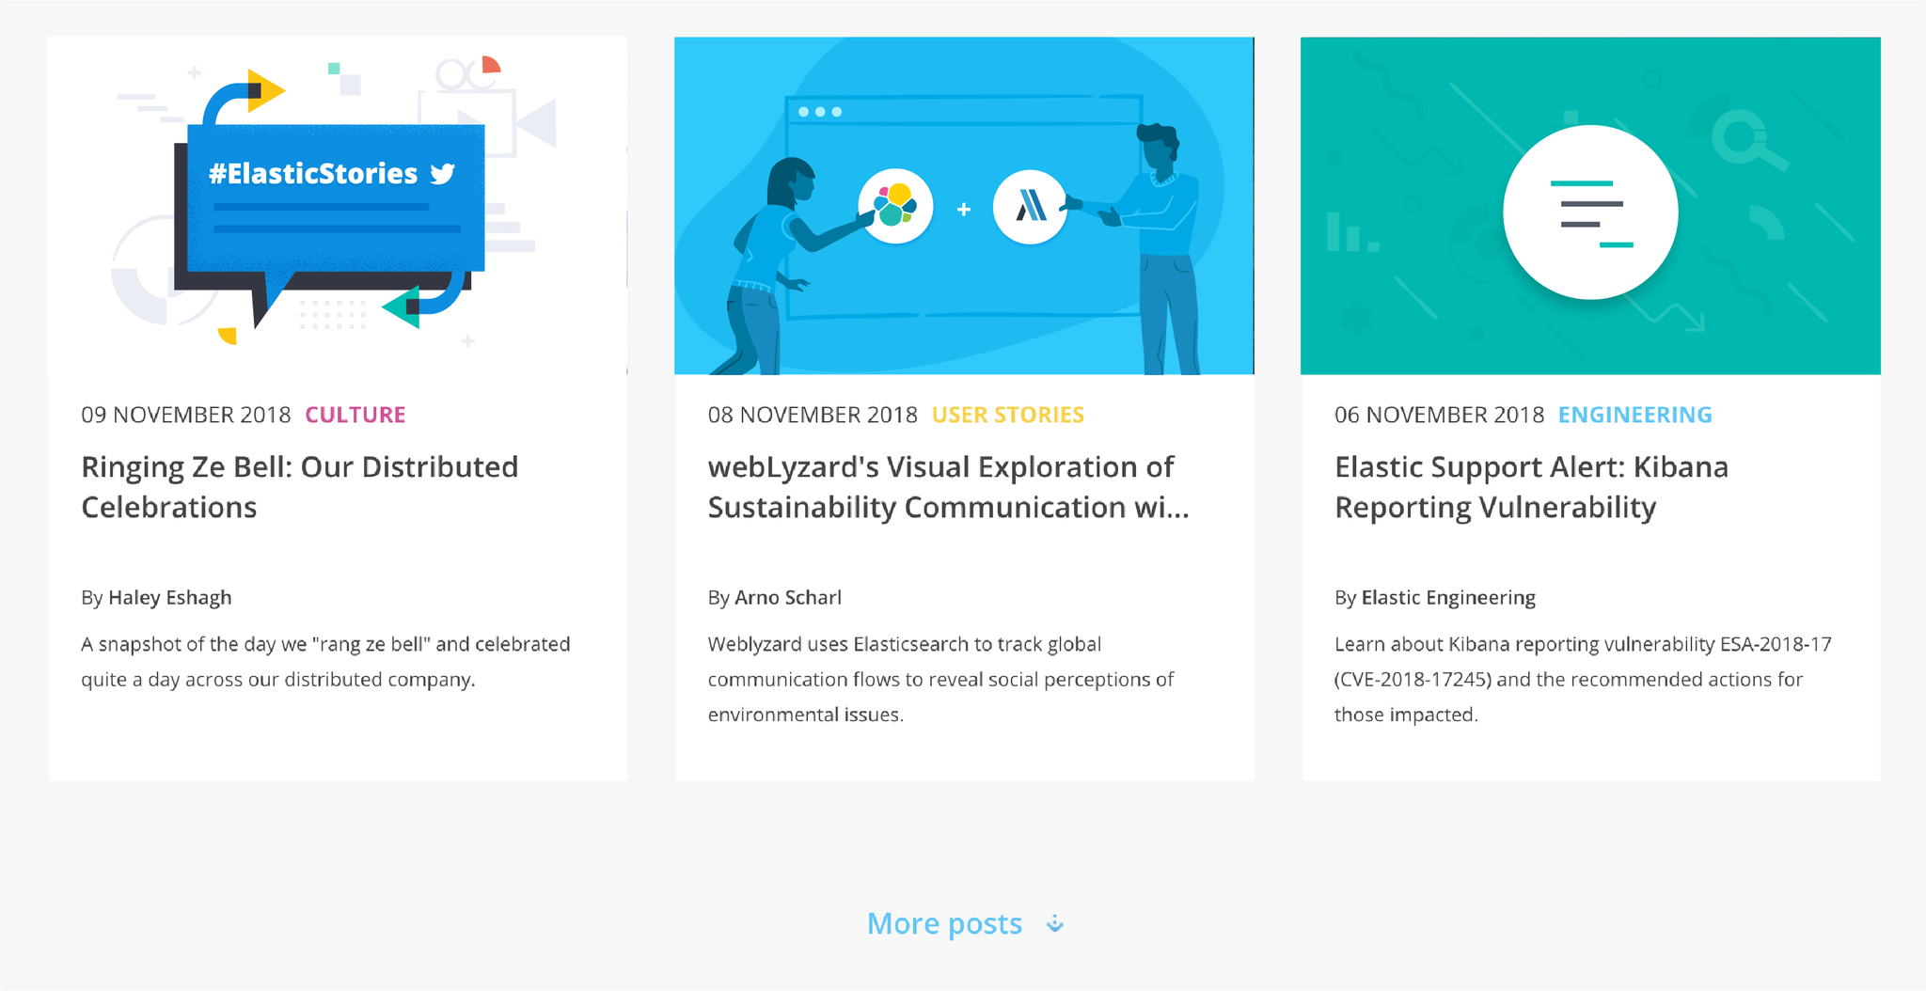
Get involved with our community! Let us know if you’re keen to share your Elastic Stack stories or host a meetup in your area

Slide 18



























FILEBEAT
METRICBEAT
MASTER (3)
CUSTOM UI
PACKETBEAT
WINGLOBEAT
INGEST (X)
AUDITBEAT
HEARTBEAT
Coordinating (X)
FUNCTION BEAT
DATA - HOT (X)
KAFKA
ELASTICSEARCH CLIENTS
DATA - WARM (X)
REDIS
DATA STORE
WEB APIS
MESSAGING
QUEUE
ALERTING (X)
WORKERS (2+)
SOCIAL
SENSORS
MACHINE LEARNING (2+)
INSTANCES (X)

